Slide 1
Final Project Proposal IT 328
Team member names: Lewis Scott, Qinghang Zhang
Project title: Recipe sharing site
A class diagram (include at least one inheritance relationship)
An ER diagram (include a minimum of two related tables)

Slide 2
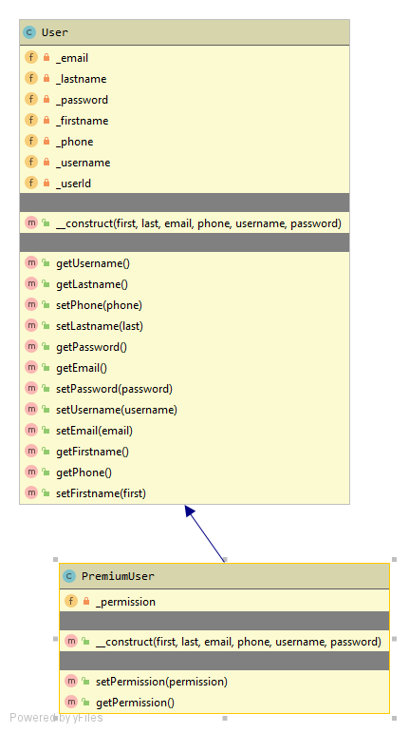
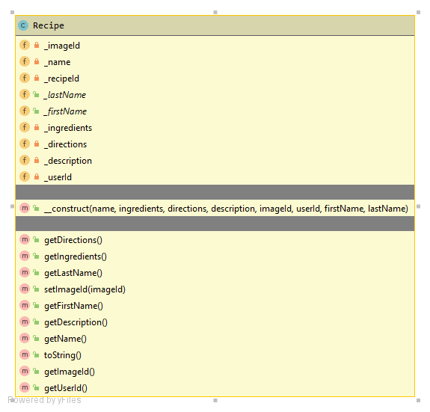
Class Diagrams (UML)

Slide 3
ER Diagram
1
1
Many
1

